Slide 1
The Cyber Risks in the 4th Industry Revolution
The CSM-ACE 2018 Conference

Slide 2
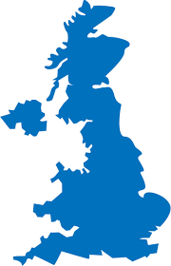
Industry Revolution
IR1
Key Output: Textile, Iron
Intermediary: Mechanisation, Labour
Input: Steam Power (water/wind/wood/coal)
IR2
Key Output: Iron, Steel
Intermediary: Medium-Tech Production
Input: Electricity
Economic Theories: Theory of Comparative Advantage
Economic Protagonist: David Ricardo
Economic Theories: Mercantilism, Theory of Absolute Advantage
Economic Protagonist: Adam Smith
1760
1840
1914
1795
1856
1914-18
World War 1
Malacca succeeded to the English
Bessemer Process was patented (iron to steel)
1939-45
World War 2
IR4
Today
IR3
1960
Key Output: Knowledge-driven
Intermediary: Robotics and Mobility
Input: AI , Deep Learning and IOT
Economic Theories: Blue Ocean
Economic Protagonist:
Output: Investment & Productivity-driven
Intermediary: High-Tech Production
Input: Internet, ICT and Multimedia
Economic Theories: Keynesian Economics
Economic Protagonist: John Maynard Keynes, Paul Krugman, Michael Porter etc.
Notes:
My interpretation of the IR, I did not realised that we bothered to coin an IR 4.0, when we have not even harnessed the full capability on the current IR. I was looking for the best explanation that suits my soul but I could not find any on the web. Being somewhat a Cartesian I tend to reduce into smaller issues and make like comparisons i.e. apple-to-apple, durian-to-durian etc. Fro the slide, you can see my feel on how the industry has move along since the dependence of labour and national endowments, along with my favourite economists.
Nothing new that I could think off, I expect a number of disruptive technologies to change the way I live before my demise. The smartphone, iPhone and the whole concept of IOS and iTunes revolutionise the way we’re doing things now. The concept of mobility advocated by these new technologies is still going along fine and making disruptive changes or perhaps more incremental innovations in the way we live. The transition from the previous stages, I believe that IR4 will rely upon the predictive element of Big Data, meaning knowledge is the prevailing driving factor. AI will be rehashed to support Deep Learning and eventually driveless vehicles, mobile technologies will make its mark in other areas and perhaps (God forbid) Trump will be the heralded economist.

Slide 3






Digital ID in IR 4.0
The Stakeholders
The National Civil
Authority
The Citizen
The Certification
Authority
The Personal Data
Protection Agency
Notes:
There’s a lot of areas that I do not know anything about, with regards to the potential risks but I think I could talk about and comment on the impact on Digital ID.
The Digital ID will progress Business-as-Usual into the IR4.0, with a little twist here and there:
For the Citizen – there will be a closer integration between the token or smartcard i.e. the ID Card and the smartphone (mobility technology), the smartphone will support multiple applets that exist in the token for example eWallets for low-value high-volume payments including transportation, sundries, top-ups etc. By the way, congratulations to Merchantrade Money Visa Prepaid Card for being the First Runner Up in the Florin Asia Innovation Awards 2018. I personally uses the Merchantrade Card and vouch for the simplicity and convenience of the card. The smartphone will marry the ID number to the smartphone number and facilitate the users for the eWallet transaction by providing info on the remaining balance, audit trail, receipts etc. The smartphone will manage doctors appointment made with the ID cards by providing dates. locations and reminders integrated with the inherent calendars in the smartphone. The information on the smartphone can be synchronised either through a secure NFS or some proximity standards that provide security for the synchronisation OR perhaps the synchronisation can be performed from the back-end via Wi-Fi or 4G etc.
The National Civil Authority or Registry in Malaysia will be JPN. The are responsible for the collection (enrolment) of the citizen’s role and the issuance and the maintenance of the civil registry. The National Civil Registry will be responsible to enhanced their services by providing eKYC capabilities to the banks, financial institutions, insurance companies including any on-line authorisation for purchases. To the National Civil Registry security can be complemented by PKI for the reading of the smartcards by the readers if the user is physically at the bank or support an OTP verification to the users while if he’s not.
The PDP Agency will provide the legislative and punitive support for miss-use or of the facilities and infrastructure. The penalties will deter potential individual hacking and corporate leakages, and also covers any problems at the National Civil Registry.
The CA will provide and support the PKI infrastructure by issuing/signing the private and public keys to support online transactions and maintaining the Trust Environment between the Stakeholders.

Slide 4
Digital ID in IR 4.0 – Potential Risks
The Banking and Financial Institutions including any merchants within this Trust Environments have the utmost responsibility to protect the citizens data in full compliance with the PDP Agency requirements.
The compliance requirement to be part of the Trusted Environment should encompasses equipment and software that has achieved a respected security level of operations to avoid being targeted as the point of entry.
Though not directly connected but the social network operator also has an ethical responsibility to protect citizens, the misappropriation of the strictly private data of billions of individuals?

Slide 5
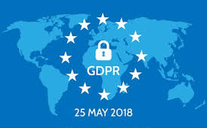
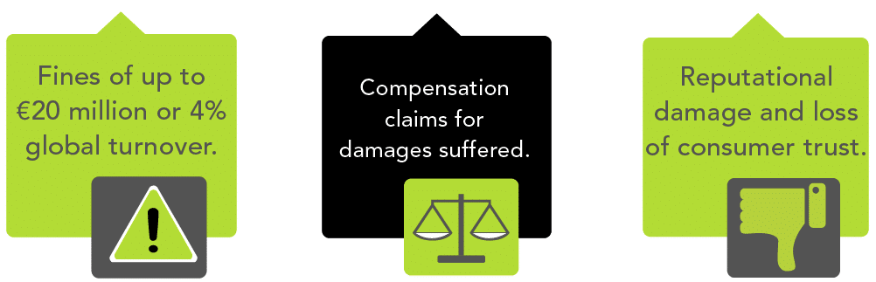
General Data Protection Act (GDPR) in EU
The GDPR is a regulation adopted by the EU that is effective by 25-May-18, which impacts not only businesses that are located in the EU, but any organization that does business with countries in the EU and/or collects data from people or businesses that reside in the EU.
It’s the start of a new world where your organization must consistently maintain an up-to-date data security readiness and demonstrate this readiness through well-documented policies and procedures.
The GDPR equips member states to enforce this regulation by each nation’s data protection authorities (DPAs). The GDPR also imposes strict penalties on organizations that fail to comply.
For violations of most technical rules, up to 2% of the global annual turnover or €10 million, whichever is higher.
For violations of the basic principles, a higher penalty of 4% of the global annual turnover or €20 million, whichever is higher, can be levied.
Notes:
For violations of the basic principles, and under aggravating circumstances, such as failure to comply with data protection authorities’ instructions, repeat violations, or unauthorized international data transfers, a higher penalty of 4 percent of the global annual turnover or €20 million, whichever is higher, can be levied.

Slide 6
Thank You

